Slide 1
Bridging to Certification
AWS Academy Cloud Architecting
Notes:
|Instructor notes
|
|Student notes
Welcome to the Bridging to Certification module. This module will bridge solutions architecting concepts to the AWS Certified Solutions Architect - Associate certification and identify resources useful for a solutions architect.

Slide 2
Introduction
Bridging to Certification
Notes:
|Instructor notes
|
|Student notes
This section identifies the course objectives and introduces information about AWS Certifications.

Slide 3
Module objectives
This module prepares you to do the following:
Identify how to prepare for the AWS Certified Solutions Architect – Associate exam.
Find resources to prepare for the exam.
Notes:
|Slide number 3
|Instructor notes
|
|Student notes

Slide 4
Module overview
Presentation sections
Solutions Architect – Associate certification domains
Solutions Architect – Associate certification exam resources
Additional resources
Notes:
|Slide number 4
|Instructor notes
|Each module has an introduction, content sections, and a wrap-up. The wrap-up for this module contains a sample exam question for you to review with the students.
|
|Student notes

Slide 5
About AWS Certification exams
Exam content
Exam scoring
Content is divided into domains and task statements.
Each domain is weighted.
Questions include multiple choice and multiple response types.
Exams have a pass or fail designation.
Unanswered questions are scored as incorrect.
Each exam includes some unscored questions that do not affect your score.
Notes:
|Slide number 5
|Instructor notes
|All of this information is within the Solutions Architect – Associate (SAA-C03) exam guide.
|
|Student notes
Each certification exam specifies content domains that will be covered in the exam. Each domain breaks down the knowledge and skills needed for that domain into task statements.
There are two types of questions on the exam:
Multiple choice questions have one correct response and three incorrect responses (distractors).
Multiple response questions have two or more correct responses out of five or more response options.
Your results for the exam are reported as a scaled score. Your score shows how you performed on the exam as a whole and whether you passed.
Unanswered questions are scored as incorrect; there is no penalty for guessing. The exam includes 50 questions that affect your score. The exam also includes 15 unscored questions that do not affect your score. Amazon Web Services (AWS) collects information about performance on these unscored questions to evaluate these questions for future use as scored questions. These unscored questions are not identified on the exam.
The AWS Certified Solutions Architect – Associate (SAA-C03) Exam Guide includes additional details on these topics.

Slide 6
About the Solutions Architect – Associate Certification
Recommended candidate for exam
Knowledge and skills validated by the exam
Performs a solutions architect role
Has at least 1 year of hands-on experience designing cloud solutions that use AWS services.
Ability to design solutions based on the AWS Well-Architected Framework
Ability to complete the following tasks:
Design solutions that incorporate AWS services to meet current business requirements and future projected needs.
Design architectures that are secure, resilient, high-performing, and cost-optimized.
Review existing solutions and determine improvements.
Notes:
|Slide number 6
|Instructor notes
|All of this information is within the SAA-C03 exam guide.
|Student notes
The slide summarizes the expected experience and knowledge for a candidate taking the Solutions Architect – Associate Certification. There are additional details in the exam preparation resources linked later in this presentation.

Slide 7
Solutions Architect – Associate Certification domains and task statements
Bridging to Certification
Notes:
|Slide number 7
|Instructor notes
|Recommend opening the exam guide.
|
|Student notes
This section describes the domains and task statements of the Solutions Architect – Associate Certification exam.
All the content in this section comes from the AWS Certified Solutions Architect – Associate (SAA-C03) Exam Guide. The exam guide is linked in your course resources and available from the AWS Certified Solutions Architect – Associate Certification web page.

Slide 8

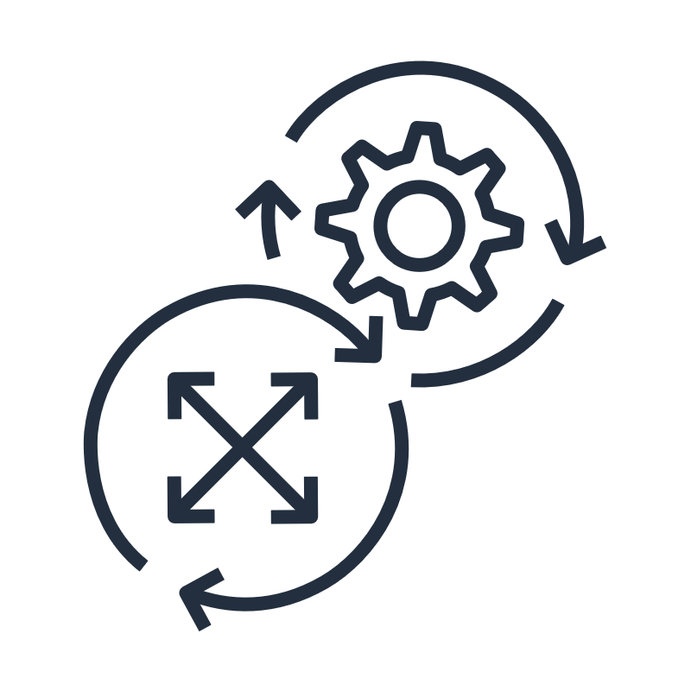



Solutions Architect – Associate content domains
Domain 1 (30%)
Domain 2 (26%)
Domain 3 (24%)
Domain 4 (20%)
Design Secure Architectures
Design Resilient Architectures
Design High-Performing Architectures
Design Cost-Optimized Architectures
Notes:
|Slide number 8
|Instructor notes
|You can go over the information on the AWS Certified Solutions Architect - Associate (SAA-C03) Exam Guide with your students. Each of the four domains have task statements that are elaborated on in the form of knowledge and skills needed. |
|Student notes
The exam content is divided into the four domains listed on the slide. Each domain has a weight that indicates its relative importance, and this weight is reflected in how questions in the exam are distributed.

Slide 9
Certification content domain 1 task statements
Design Secure Architectures (30%)
1.1: Design secure access to AWS resources.
1.2: Design secure workloads and applications.
1.3: Determine appropriate data security controls.
Notes:
|Slide number 9
|Instructor notes
|Each of the domain slides can be used as a reviewing opportunity. The content related to this domain is spread across multiple modules and sections. Together, the students can recall the areas related to this domain that took longer to learn or that they have lab experiences with.
|
|Student notes
Security is a constant theme throughout the exam. You need to know the services related to security, in addition to security concepts and how they affect the decisions you will evaluate about various services and solutions. Security should be considered at every stage, level, and tier of your applications and architectures.
Consider secure solutions for every topic. Domain 1 is broken into three task statements stated on the slide.
The following are some big-idea topics and questions related to the first domain:
Which services can we use to follow the Principle of Least Privilege when working in a multi-account environment? Would you use AWS Control Tower, AWS Service Catalog, or AWS Organizations?
Be sure you have a good understanding of AWS Identity and Access Management (IAM). When would you use an AWS IAM role, and when would you use an IAM user? Know the difference between a resource policy, a permissions policy, and a service control policy (SCP). How are policies evaluated when there are overlapping allow and deny rules?
Know different ways to federate into AWS. Be sure to know the AWS IAM Identity Center service and different use cases for AWS Directory Service.
Understand which monitoring services exist, including Amazon CloudTrail, Amazon CloudWatch, and VPC Flow Logs.
Know the different use cases and capabilities of AWS Shield, AWS WAF, AWS Secrets Manager, and AWS Systems Manager Parameter Store.
Make sure you know how you can protect your data in transit and at rest in AWS.
In which case would you choose AWS Key Management Service (AWS KMS) or AWS CloudHSM?

Slide 10
Certification content domain 2 task statements
Design Resilient Architectures (26%)
2.1: Design scalable and loosely coupled architectures.
2.2: Design highly available and/or fault-tolerant architectures.
Notes:
|Slide number 10
|Instructor notes
|Each of the domain slides can be used as a reviewing opportunity. The content related to this domain is spread across multiple modules and sections. Together, the students can recall the areas related to this domain that took longer to learn or that they have lab experiences with.
|
|Student notes
A resilient workload has the capability to recover when stress by loads, attacks, either accidental or through a bug, or deliberate, through intention, and failure of any component in the workload’s components.
Dive deeper into high availability, fault tolerance, disaster recovery, elasticity, and scalability. Domain 2 is broken into two task statements stated on the slide.
The following are some big-idea topics and questions related to the second domain:
An understanding of AWS Global Infrastructure is required to design resilient workloads across Availability Zones and across AWS Regions.
Which services could you use to create an environment that can tolerate a single point of failure of a single Amazon Elastic Compute Cloud (Amazon EC2) instance or a loss of an entire Availability Zone?
Ensure you understand Elastic Load Balancing (ELB), Amazon EC2 Auto Scaling, and AWS Auto Scaling. You should know how to use AWS services to automatically scale up and down to match demand.
Understand the use cases for Amazon Route 53 with failover routing or latency-based routing, in addition to AWS Global Accelerator.
Know the different disaster recovery strategies.
Know which AWS managed services have built-in resilience, such as Amazon Simple Queue Service (Amazon SQS), AWS Lambda, and AWS Fargate. Know their capabilities and their appropriate use cases.
Ensure you understand serverless technologies and patterns and the differences between stateful and stateless applications.
Know which services you can use to offload some of your frequent traffic to data stores such as read replicas and Amazon ElastiCache.

Slide 11
Certification content domain 3 task statements
Design High-Performing Architectures (24%)
3.1: Determine high-performing and/or scalable storage solutions.
3.2: Design high-performing and elastic compute solutions.
3.3: Determine high-performing database solutions.
3.4: Determine high-performing and/or scalable network architectures.
3.5: Determine high-performing data ingestion and transformation solutions.
Notes:
|Slide number 11
|Instructor notes
|Each of the domain slides can be used as a reviewing opportunity. The content related to this domain is spread across multiple modules and sections. Together, the students can recall the areas related to this domain that took longer to learn or that they have lab experiences with.
|
|Student notes
There are a few major layers to think about when designing high-performing solutions on AWS. You have the storage layer, the computer layer, the database layer, and the network layer. You also have to think about your data ingestion and transformation. The optimal solution for a particular workload varies. Well-architected workloads use multiple solutions and use different features to improve performance. It is important to use data obtained through benchmarking or load testing to continually optimize your architecture. Domain 3 is broken into five task statements stated on the slide.
The following are some big-idea topics and questions related to the third domain:
Understand the differences between object storage, block storage, and file storage. Be sure to know services such as Amazon Simple Storage Service (Amazon S3), Amazon Elastic File System (Amazon EFS), Amazon FSx, and Amazon Elastic Block Store (Amazon EBS).
Know how you can scale with different compute services including Amazon EC2, Amazon EMR, AWS Fargate, and AWS Lambda.
Understand how other serverless technologies, including Amazon API Gateway, AWS Step Functions, and Amazon EventBridge, can include overall performance.
Know the capabilities and limitations of Amazon Relational Database Service (Amazon RDS), Amazon Aurora, Amazon DynamoDB, Amazon Elasticache, and Amazon Redshift. How do read replicas work for the services that support them? Which database services provide cross-Region support?
Understand different caching strategies such as lazy loading and write through.
Know which services and solutions can help optimize network traffic, such as Amazon CloudFront, AWS Global Accelerator, and Amazon Virtual Private Cloud (Amazon VPC) endpoints.
Know the different data ingestion patterns and data transfer services, such as AWS DataSync, AWS Storage Gateway, and the AWS Transfer Family options.

Slide 12
Certification content domain 4 task statements
Design Cost-Optimized Architectures (20% )
4.1: Design cost-optimized storage solutions.
4.2: Design cost-optimized compute solutions.
4.3: Design cost-optimized database solutions.
4.4: Design cost-optimized network architectures.
Notes:
|Slide number 12
|Instructor notes
|Each of the domain slides can be used as a reviewing opportunity. The content related to this domain is spread across multiple modules and sections. Together, the students can recall the areas related to this domain that took longer to learn or that they have lab experiences with.
|
|Student notes
Cost optimization is the ability to deliver business value at the lowest price point. To understand this domain, it will help to understand the Cost Optimization pillar of the AWS Well-Architected Framework. Whenever architecting AWS solutions, it’s important to look at how you can minimize cost across storage, compute, database, and network resources. Domain 4 is broken into four task statements stated on the slide.
For example, through monitoring, you might discover that your EC2 instances are underutilized. This gives you an opportunity to right size the instance for the application and workload or scale in. By doing so, you would be reducing your EC2 instance charges from that point forward. The following month, you might turn on Amazon S3 Intelligent-Tiering to take advantage of the correct storage classes based on your access patterns. Knowing where to look for cost-optimization opportunities and knowing how to optimize cost help you make the most appropriate architectural decisions.
The following are some big-idea topics and questions related to the fourth domain:
For compute solutions, with EC2 instances, choose the most appropriate instance type and size. With Lambda, you can optimize by writing functions that consume less resources and are more efficient for runtime. For containers, you can save by having smaller, more lightweight containers, and choose the appropriate compute platform for your containers.
Understand the cost management tools, such as AWS Cost Explorer, AWS Cost and Usage Reports, and AWS Budgets. Know how to configure tags to be used with cost reporting tools.
For storage solutions, know the different automated methods for switching between Amazon S3 storage classes. Understand different scaling strategies, such as Amazon EC2 Auto Scaling and hibernation. Take advantage of the appropriate storage tiers. You can optimize for cost by choosing the appropriate Amazon EBS volume types and sizes and by managing the lifecycle snapshots for Amazon EBS volumes or database backups.
For database solutions, choose the right database for your use case. Know how to take advantage of caching instead of always scaling up and out.
For networking solutions, know how the services work, their use cases, and the cost implications. After meeting the requirements, consider which design is the most cost-optimized. For example, how can you minimize your virtual private cloud (VPC) cost? How can you minimize cost for NAT gateways in a development VPC? How can you configure your network routes to minimize data-transfer costs?

Slide 13
Solutions Architect – Associate Certification exam preparation resources
Bridging to Certification
Notes:
|Slide number 13
|Instructor notes
|
|Student notes
This section describes the resources related to the certification exam.

Slide 14
AWS Certification resources
Webpage address | Description
https://aws.amazon.com/certification | AWS Certification overview: Includes links to resources and information about each certification
https://aws.amazon.com/certification/certified-solutions-architect-associate | AWS Certified Solutions Architect – Associate Certification: Includes details about the Solutions Architect – Associate exam with links to exam guide, sample questions, and available training
Notes:
|Slide number 14
|Instructor notes
|The suggested presentation of this module is to open the AWS Solutions Architect – Associate Certification page and navigate with students to the online resource related to the slides presented in this section. Encourage students to go to the same pages and bookmark the primary resources so that they can conveniently find them later.
|
|Student notes
The two webpages linked on this screen are your starting points for learning about AWS Certifications and the AWS Certified Solutions Architect exam. This section will highlight key resources that you will find linked from these webpages. It is a good idea to bookmark these webpages as your starting points.

Slide 15
Free exam readiness resources
Title | Description
Exam Guide | PDF document that explains the test and the certification domains in detail Appendix includes technologies and concepts that might appear on the exam, and in-scope and out-of-scope AWS services and features
Sample questions | PDF document with ten questions that demonstrate the format of the questions used on the exam Includes rationales for the correct answers
AWS Certified Solutions Architect – Associate webinar | 3-hour virtual event that explores topic areas and how they map to architecting on AWS and to specific areas of study Requires registration
Exam Prep Standard Course: AWS Certified Solutions Architect – Associate | Digital training course that walks you through each of the domains, explaining what you should know Includes reviews of exam-style questions Requires an AWS Skill Builder account
Exam Prep Official Practice Question Set: AWS Certified Solutions Architect - Associate | 20 exam-style questions delivered online in a format similar to the certification exam Includes detailed feedback and recommended resources to help you prepare for your exam Requires an AWS Skill Builder account
Notes:
|Slide number 15
|Instructor notes
|Navigate to the main page for AWS Certified Solutions Architect – Associate page (linked on the Certification overview slide) and demonstrate where to access each of these resources. Students will be able to schedule an exam from the main page as well. Direct links are provided in the course resources.
|
|Resources on this list are free for students to access.
| |The 20 practice questions in the Exam Prep Official Practice Question Set are different from the 10 sample questions in the PDF. Encourage students to benefit from all the free questions available to them.
|
|As you open the webinar link, show students to the language and time zone the webinar is offered in.
|
|Student notes
These free resources will help you prepare for the certification exam. All the resources listed on this page are linked from the AWS Certified Solutions Architect – Associate Certification web page listed on the previous slide. Download the exam guide and the sample questions. Scroll down to the Prepare for your exam section on that same page for links to the webinar, digital course, and online practice test.

Slide 16
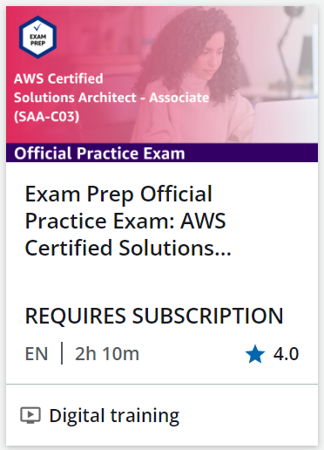
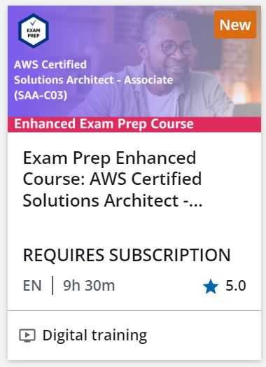
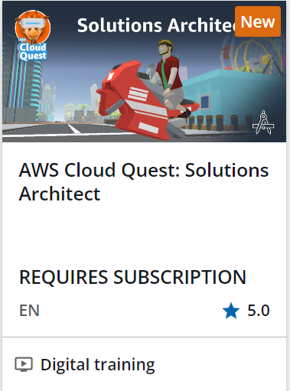
Exam readiness with an AWS Skill Builder subscription
Notes:
|Slide number 16
|Instructor notes
|Students will need to subscribe to AWS Skill Builder for access to additional practice materials to help them prepare for the exam.
|Watch the video on the AWS Cloud Quest Solutions Architect webpage to demo what this gamification resource is about.
|Also explain that additional training is available on the AWS Training webpage using the link provided in the resource page.
|
|Student notes
The following subscription-based resources will help you prepare for the certification exam:
AWS Certification Official Practice Exam: The AWS Certified Solutions Architect - Associate (SAA-C03 - English) includes 65 questions and has a time limit of 130 minutes. This full-length practice exam aligns with the SAA-C03 version of the exam and exam guide. This practice exam has the same style, depth, rigor, and scoring as the actual exam and can help you gauge your knowledge and preparedness for the exam.
Enhanced digital training: This digital course includes practice materials like videos, hands-on exercises (builder labs), additional practice questions, and access to the Official Practice Exam.
AWS Cloud Quest: AWS Cloud Quest is a role-based learning game that helps you build practical AWS skills through exercises and hands-on activities using AWS services. Within AWS Cloud Quest, there are roles you can choose from several technical domains. After starting AWS Cloud Quest, choose the Solutions Architect role to explore solution-building assignments that cover a broad range of AWS services curated by AWS experts. As the city’s solution architect, you will implement solutions based on a broad set of AWS services. You will build solutions that scale network connectivity, secure data, and manage resources using the AWS Well-Architected Framework.
For more information, see the content resources page of your online course.

Slide 17
Additional resources
Bridging to Certification
Notes:
|Slide number 17
|Instructor notes
|
|Student notes
This section describes the resources related to learning more about the concepts and services needed in solutions architecting. These are resources that will support your learning to prepare for the exam but are also resources that you will use as you gain experience or take on a role as a cloud architect.

Slide 18
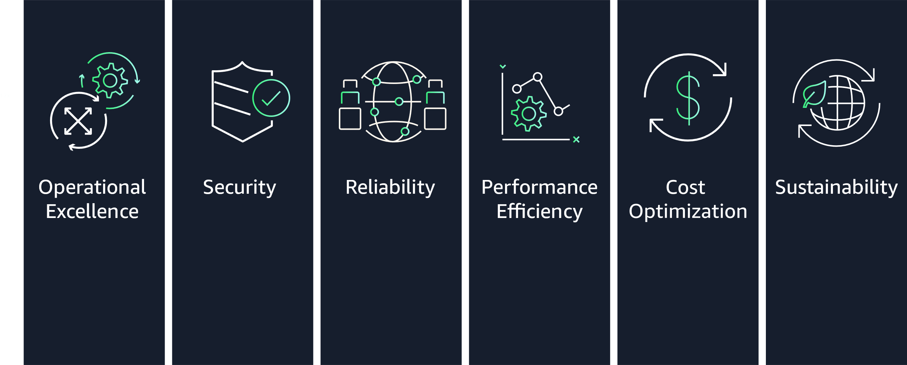
AWS Well-Architected Framework
Notes:
|Slide number 18
|Instructor notes
|Navigate to the Well-Architected Framework main page and show the framework overview section along with the six pillars.
|
|An extension would be to show the AWS Well-Architected Framework Lens. The AWS Well-Architected Framework Lens extends the guidance offered by AWS Well-Architected to specific industry and technology domains. These include machine learning (ML), data analytics, serverless, high performance computing (HPC), Internet of Things (IoT), SAP, streaming media, the games industry, hybrid networking, and financial services. To fully evaluate workloads, use applicable lenses together with the AWS Well-Architected Framework and its six pillars.
|
|Student notes
Throughout this course, you have learned about using the Well-Architected Framework to apply best practices to your architectures. To prepare for the AWS Certified Solutions Architect - Associate exam, focus on reading the whitepaper for the AWS Well-Architected Framework and for each of the pillars. Give particular focus to Security, Reliability, Cost Optimization, and Performance Efficiency. For more information, see the content resources page of your online course.

Slide 19
Centralized hubs for finding AWS resources
Description | Webpage
AWS Architecture Center | https://aws.amazon.com/architecture
AWS Documentation (services) | https://docs.aws.amazon.com
AWS Frequently asked questions (FAQs) | https://aws.amazon.com/faqs
Getting Started Resource Center | https://aws.amazon.com/getting-started
AWS Builder Labs (Subscription-based hands-on labs) | https://aws.amazon.com/training/digital/aws-builder-labs
AWS Ramp-Up Guides | https://aws.amazon.com/training/ramp-up-guides
Notes:
|Slide number 19
|Instructor notes
|You might want to open each of these links and have the students do the same while you are on this slide. The remaining slides discuss items that can be reached from each of these hubs, although most also have direct links that you might suggest students bookmark.
|
|Student notes
Each of these hub pages bring together a variety of resource links. Frequently, you will find different pathways that lead to some of the same resources. For example, individual videos from the series listed on the AWS Architecture Center page often appear on pages dedicated to a specific technology category. Additionally, relevant sections of the Well-Architected Framework are linked from a variety of guides. The remaining slides in this section highlight some of the resources available from these hubs that might be helpful when preparing for the certification exam.
Beyond that, these are resources you will want to bookmark and come back to as you start to build AWS solutions and as you continue to deepen your knowledge of cloud architecting.

Slide 20
Architecture Center resource categories
Best practices
Video series
Libraries
Organized by technology category
Presented in the context of a project's lifecycle steps
Focused on practical use cases
Presented by AWS Solutions Architects, AWS Partners, and customers
Organized into searchable and filterable collections
Includes the following:
Reference architectures
Whitepapers
Quick Starts
Notes:
|Instructor notes
|Navigate to an example of each of the items and highlight the available resources. Direct links to the reference architectures, white papers, and Quick Starts are included in the course resources. However, it might be helpful to guide the students to get there from the architecture webpage, so they only have to bookmark one link.
|
|Student notes
Three useful categories of resources found through the architecture center are best practices, video series, and libraries. As you explore each of these, you will find items cross-referenced across categories and sections (for example, a best practice page might include a video from one of the video series and a link to a diagram from the reference architecture library).
Best practices: Select a technology category from the top menu to find the related best practices. Review the following project steps: get started, learn and design, build and test, deploy, and audit and optimize. For certification preparation, the most relevant resources are mostly in the get started and learn and design sections.
Video series: Select a video series from the top menu and then use the available filters to find videos of interest for that series.
Libraries: Select a library and then use available filters to find resources of interest. For the purpose of learning more to prepare for the certification exam, the most relevant options are the reference architectures and whitepapers. Some Quick Start resources might also be helpful.
Quick Starts are automated reference deployments built by AWS solutions architects and AWS Partners. Quick Starts use CloudFormation templates to reduce hundreds of manual procedures into a few steps, so you can build your production environment quickly and start to use it immediately.
Each Quick Start includes the following:
A reference architecture for the deployment
An AWS CloudFormation template that automates the deployment
An implementation guide that discusses the architecture and provides step-by-step deployment instructions
Some AWS Quick Starts will explain the benefits of the solution provided, while others might provide connections to the Well-Architected Framework.
Even if you aren't ready to deploy a solution, the reference architectures and implementation guides might be helpful for understanding how to architect AWS solutions for a given use case.

Slide 21
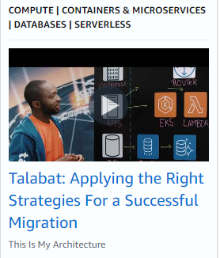
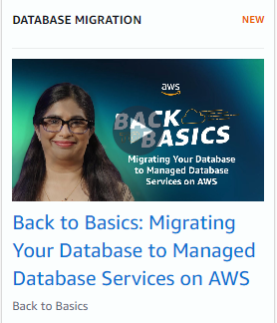
Suggested AWS Video Series for architecting
This is My Architecture
Back to Basics
AWS Cloud customers and partners explain elements of their specific architectural solutions.
https://aws.amazon.com/architecture/this-is-my-architecture
AWS SAs explain a specific architectural building block independent of a particular cloud solution.
https://aws.amazon.com/architecture/back-to-basics
Notes:
|Slide number 21
|Instructor notes
|Navigate to the This is My Architecture video series and the Back to Basics video series using the links in the resource page. Search for the two videos shown on the slide; the titles are also in the student notes. Compare the perspective and purpose of each migration-related video.
|
|Student notes
The This is My Architecture video series and the Back to Basics video series are beneficial for learning more about how AWS services are applied and the types of problems they solve.
This is My Architecture: This video series can help you learn about the innovative cloud architectures that AWS Partners and customers have built. An example of this collection is “Talabat: Applying the Right Strategies for a Successful Migration:” Join Moe from AWS as he walks through Talabat's architecture and explains the different migration strategies in Talabat's migration journey from bare-metal data center to AWS. Talabat has chosen lift-and-shift, re-platforming, and re-architecting migration strategies based on the application and database complexity to deliver a successful phased migration journey.
Back to Basics: This video series explains and examines basic cloud architecture pattern best practices. Each episode is hosted by an AWS Solutions Architect and focuses on a specific architectural building block independent of a specific cloud solution. An example of this collection is “Back to Basics: Migrating Your Database to Managed Database Services on AWS”. If you manage applications or databases, you will likely have to deal with database migrations from time to time. This migration could be initiated by a project to modernize an application or to meet business growth requiring a modern database. Join Pranjali as she shares a solution pattern to migrate and modernize your database services.

Slide 22

AWS service documentation at docs.aws.amazon.com
Select a service from the Product guides and references section
User guides, developer guides, and best practices are good sources for certification exam preparation.
Helpful sections in these resources include the following:
What is
How it works
Getting started
Notes:
|Slide number 22
|Instructor notes
|Navigate to the AWS documentation using the link in the resource page or the earlier slide. Show the Product guides and references section where students can search for all products directly or by product category.
|
|Suggest opening a guide that has been referenced earlier in the course, such as the AWS Glue User Guide. (Type Glue into the search box in the Product guides and references section, choose AWS Glue from the search results, then choose What is AWS Glue to open the guide.) Show students the “Getting Started” part of the user guide and expand some of the topics to show the clear steps that are helpful. Also point out the other related sections on the left bar.
|
|Student notes
AWS Documentation is the source of truth for AWS services and features. You can find user guides, developer guides, API references, tutorials and projects, SDKs and toolkits, and various other general resources within the AWS Documentation.
Some services have both user guides and developer guides. Both can be helpful for learning about the service. Most guides include a What is, How it works, and Getting started section. The Getting started section topics have step-by-step tutorials that can help familiarize you with the services.

Slide 23
AWS FAQ resources
Product-related
Cloud computing concepts
Cloud comparison tool
Select a product to navigate to its product page FAQ.
Examples include the following:
Amazon EC2 Auto Scaling FAQ
Amazon S3 FAQ
Choose a question or follow the link to the Cloud Computing Concepts Hub to search for questions by topic.
Examples include the following:
What is machine learning (ML)?
What is Data Mining?
Choose a topic or follow the link to the Cloud Comparison tool to search for comparisons by topic.
Examples include the following:
ETL vs. ELT
Artificial Intelligence vs Machine Learning
Notes:
|Slide number 23
|Instructor notes
|Navigate to the AWS FAQs page using the link in the resource page. Choose one topic or service and look for relevant resources in each of the three sections explained in the students notes. One example is exploring artificial intelligence and machine learning (AI/ML) concepts and services, as shown on the slide.
|
|Student notes
Reviewing frequently asked questions can be helpful as you learn more cloud architecting concepts and services. The AWS FAQs page consists of the following three sections:
Product-related FAQs: Browse through these FAQs to find answers to commonly raised questions for each product. You will see product categories, such as artificial intelligence or machine learning, with AWS products under each category.
Cloud computing concepts FAQs: This is the centralized place where you can browse or search for informative articles about cloud computing. You will find straightforward information about broad topics, such as "What is data science?" and "What is machine learning?“ These articles are intended to help you level up your understanding of frequently asked cloud computing topics.
Cloud comparison tool FAQs: This section features content that helps readers understand common use cases for when to use one cloud solution or another. Compare and contrast cloud solutions and learn the nuances of different use cases that work best for your situation.

Slide 24
Getting Started Resource Center links
Hands-on Tutorials
Decision guides
Filter by technology category and tutorial type (Getting Started guides, How-To guides, and tutorials).
Available directly at https://aws.amazon.com/getting-started/hands-on
Select a technology category to read the related guide.
Available directly at https://aws.amazon.com/getting-started/decision-guides
Notes:
|Slide number 24
|Instructor notes
|Navigate to the AWS Getting Started page using the link in the resource page. Show students a hands-on tutorial and an AWS Decision guide of your choice.
|
|Student notes
More resources that are helpful on your solutions architecting journey are located on the Getting Started with AWS webpage. Use the top menu to find links to many of the other resources described in this section, in addition to available training. Particularly useful for ramping up or preparing for the Solutions Architect – Associate exam are the hands-on tutorials and AWS Decision Guides:
Hands-on Tutorials include getting started guides, how-to guides, and tutorials. Hands-on practice with the service will help you gain experience with the services and put course topics in new context.
AWS Decision guides help you choose the services that might be right for you and your use cases. The Decision guides cover topics such as analytics, containers, development strategy, storage, application integration, databases, and machine learning (ML). Reviewing the factors that guide service choices will be helpful in preparing you for the kinds of scenarios that might be included on the exam. In particular, the Choose section of each guide provides a quick summary of services and distinguishing characteristics for when to choose each.

Slide 25

AWS Builder Labs
Browse the catalog of self-paced labs available.
Self-paced labs run in an AWS environment similar to the labs in the course.
Labs require a Skill Builder subscription.
Notes:
|Slide number 25
|Instructor notes
|Navigate to the AWS Builder Labs page using the link in the resource page. Scroll down to the “Featured labs in AWS Skill Builder” section and select a self-paced lab to show students. The link will direct you to AWS Skill Builder.
|
|Student notes
Practice AWS Cloud skills in a live sandbox environment with AWS Builder Labs. Self-paced guided labs are interactive exercises with step-by-step instructions to help you learn cloud skills.
When logged in AWS Skill Builder, use the course catalog and filter for Training Category: Self-Paced Lab.

Slide 26

AWS Ramp-Up Guides
Explore the following guides by role, solution, or industry area.
Downloadable guides with curated links from AWS classroom and digital curricula, video library, and AWS Builder Labs
The Solutions Architect Ramp-Up Guide which includes specific resources from many of the resource types highlighted in this module.
To access the Solutions Architect Ramp-Up Guide see https://d1.awsstatic.com/training-and-certification/ramp-up_guides/Ramp-Up_Guide_Architect.pdf
Notes:
|Slide number 26
|Instructor notes
|Navigate to the AWS Ramp-Up Guides webpage and show the options for ramping up by role and solution. Choose Browse by Role, then choose Download the guide under the Solutions Architect role. Highlight the estimated duration and type of each resource. Show the dollar sign on the left of some resources, which indicates that there is a cost associated with the resource.
|
|Student notes
Each Ramp-Up Guide is the compilation of the most salient learning resources from our classrooms, digital curricula, video library, and AWS lab environment that relate to the preparing for a Solutions Architect Role. This guide is not intended to be consumed entirely. Different sections tackle different objectives. Some resources will be less relevant to you today. The guide will help you decide where you want to start your learning journey, and which step should be your next.

Slide 27
Module wrap-up
Bridging to Certification
Notes:
|Slide number 27
|Instructor notes
|
|Student notes
This section summarizes what you have learned and brings the module to a close.

Slide 28
Module summary
This module prepared you to do the following:
Identify how to prepare for the AWS Certified Solutions Architect – Associate exam.
Find resources to prepare for the exam.
Notes:
|Slide number 28
|Instructor notes
|
|Student notes

Slide 29
Thank you
Corrections, feedback, or other questions?
Contact us at https://support.aws.amazon.com/#/contacts/aws-academy.
Notes:
|Slide number 29
|Instructor notes
|
|Student notes
That concludes this module. The Content Resources page of your course includes links to additional resources that are related to this module.

